Slide 1

SBOL Visual: Diagrams for Synthetic Biology
Presenter: Jacob Beal (BBN Technologies)
SBOL Workshop @ iGEM, November, 2019
Boston, MA, USA
This document does not contain technology or technical data controlled under either U.S. International Traffic in Arms Regulation or U.S. Export Administration Regulations.

Slide 2
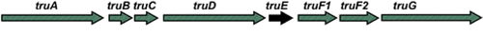
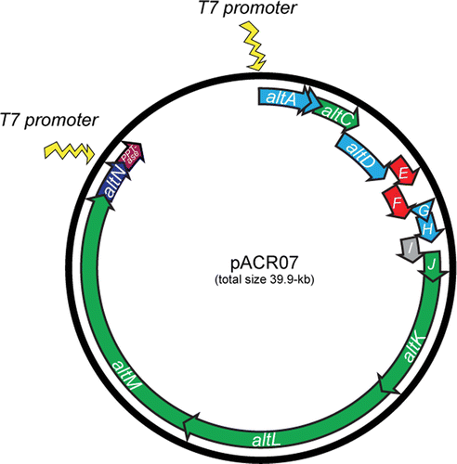
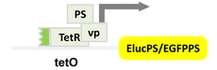
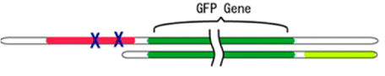
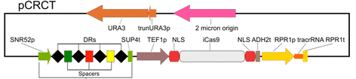
Problem: Communicating Gene Constructs
Construct diagrams from some recent ACS Syn.Bio. papers:
Well, they're sort of similar…
Notes:
I'm not picking on anybody - I just took the most recent 5 "just publishable" papers with constructs

Slide 3
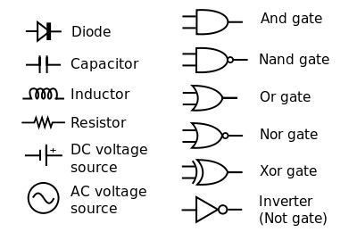
Standards simplify communication
Inspiration: Standard Electronic Symbols:
What is the equivalent for synthetic biology?
… and many others in IEEE Std. 91/91a; IEEE Std. 315
Notes:
Image courtesy of Wikipedia

Slide 4
Diagram Elements
Sequence Feature Glyphs
Molecular Species Glyph
Module
Nucleic Acid
Backbone
GFP
pTet
gfp
tetR
Interactions
Labels
Reverse Complement
Sequence Feature Glyphs
Interaction Node
aTc

Slide 5
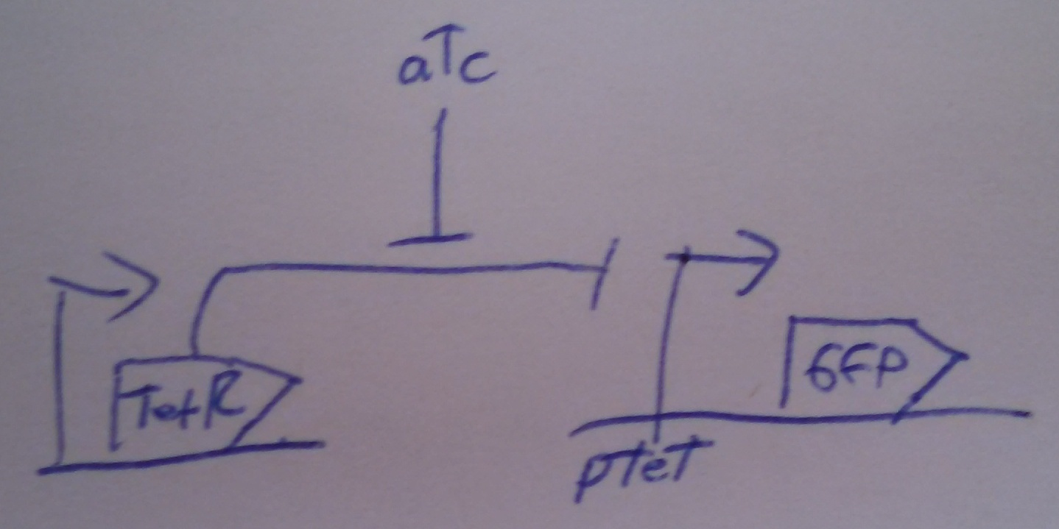
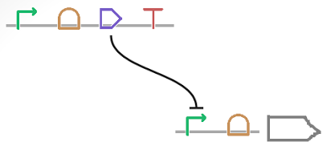
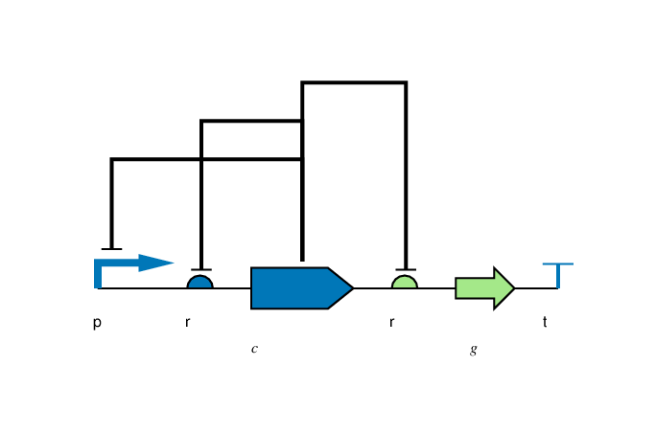
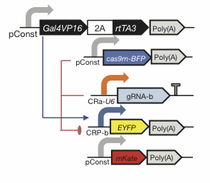
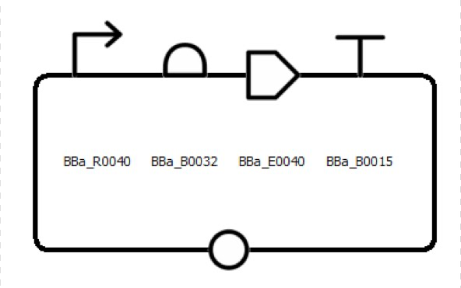
Flexibility of Style
Color, Text, Scaling, Strands, Styling: all your choice

Slide 6
Nucleic Acid Glyphs

Slide 7
Molecular Species & Interaction Glyphs
Molecular Species
superpose glyphs
alternate
recommended alternate
Complex
Macromolecule
Protein
No Glyph
Nucleic Acid (Generic)
alternates
recommended alternate
Nucleic Acid (1-Strand)
Nucleic Acid (2-Strand)
Simple Chemical
Unspecified
Interaction
Control
Degradation
Inhibition
Process
Stimulation
Association
Dissociation
Process

Slide 8
Making SBOL Visual Diagrams
Using your favorite graphics editor:
Many glyphs can be drawn directly
Glyph set available: http://sbolstandard.org/visual/
Specialized visualization tools:
VisBOL: http://visbol.org/design/
GraphViz: http://www.graphviz.org/
DNAPlotLib: https://github.com/VoigtLab/dnaplotlib

Slide 9
Example: CRISPR Device

Slide 10
Example: CRISPR Circuit

Slide 11
Example: Rule 30 Circuit

Slide 12
Example: Pathway Engineering

Slide 13
Example: Genome Engineering

Slide 14
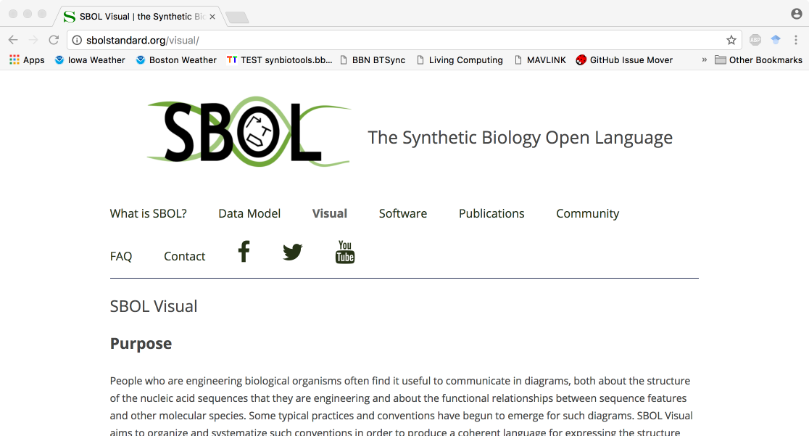
http://sbolstandard.org
Use the symbols in your papers & talks
Contribute opinions, use cases, new symbols
Community is open for anyone to join

